Slide 1
Michael Degermann
GerDa, Nachhaltigkeit im UR bei FMS
Fach: Hydraulik
28-04-2026
Michael Degermann
1

Slide 2
Dialogischer Unterricht - Olga Dysthe
Illeris' Lerndreieck
Meyer und Wubbels
UN-Ziele für nachhaltige Entwicklung
UNESCO persönliche Kompetenzen
28-04-2026
Michael Degermann
2

Slide 3
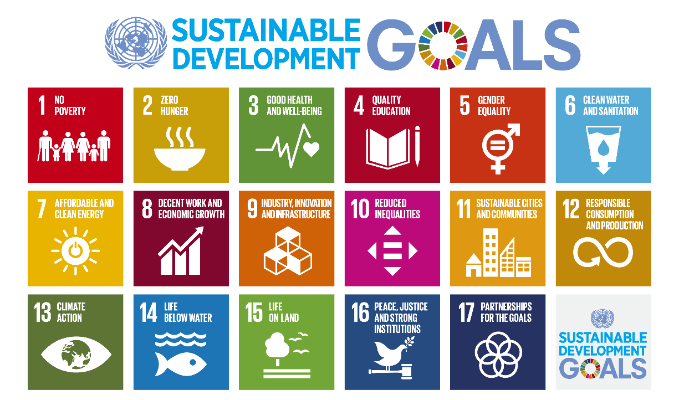
28-04-2026
Michael Degermann
3

Slide 4
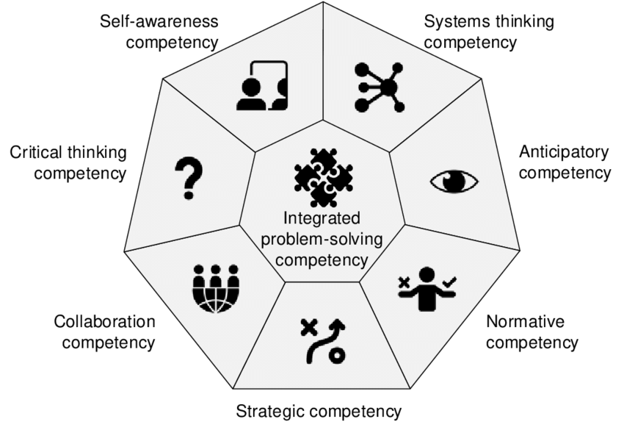
Quelle: [PDF] MAPPING THE CDIO SYLLABUS TO THE UNESCO KEY COMPETENCIES FOR SUSTAINABILITY | Semantic Scholar
28-04-2026
Michael Degermann
4

Slide 5
28-04-2026
Michael Degermann
5

Slide 6
Zeitplan für Unterricht 4x45 Minuten
30-120 Minuten: Gruppenarbeit (Material zur Präsentation) und Supervision des Unterrichts
Aktivität: Die Studierenden arbeiten in Gruppen an spezifischen Aufgaben zu Pumpenkonstruktion, Funktionsweise, Anwendungs-bereichen usw. sowie Vor- und Nachteilen hinsichtlich: Technik, Wirtschaft und Umwelt.
Gruppe 1 (Axialkolbenpumpe)
Gruppe 2 (Radialkolbenpumpe)
Gruppe 3 (Zahnradpumpe)
Gruppe 4 (Zahnringpumpe)
Gruppe 5 (Flügelzellenpumpe)
28-04-2026
Michael Degermann
6

Slide 7
Integrated problem-solving competency:
the overarching ability to apply different problem-solving frameworks to complex sustainability problems and develop viable, inclusive and equitable solution that promote sustainable development, integrating the above mentioned competencies.
Critical thinking competency:
the ability to question norms, practices and opinions; reflect on own one’s values, perceptions and actions; and take a position in the sustainability discourse
Self-awareness competency:
the ability to reflect on one’s own role in the local community and (global) society, continually evaluate and further motivate one’s actions, and deal with one’s feelings and desires.
Collaboration competency:
the ability to learn from others; understand and respect the needs, perspectives and actions of others (empathy); understand, relate to and be sensitive to others (empathic leadership), deal with conflicts in a group; and facilitate collaborative and participatory problem-solving
Quelle: Issues and trends in education for sustainable development - UNESCO Digital Library
28-04-2026
Michael Degermann
7

