Slide 1
Sustainability Didactics
FMS TE-BM6 English
Sustainability in FMS TE-BM6 English

Slide 3
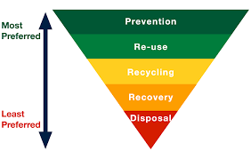

Slide 6


Slide 7
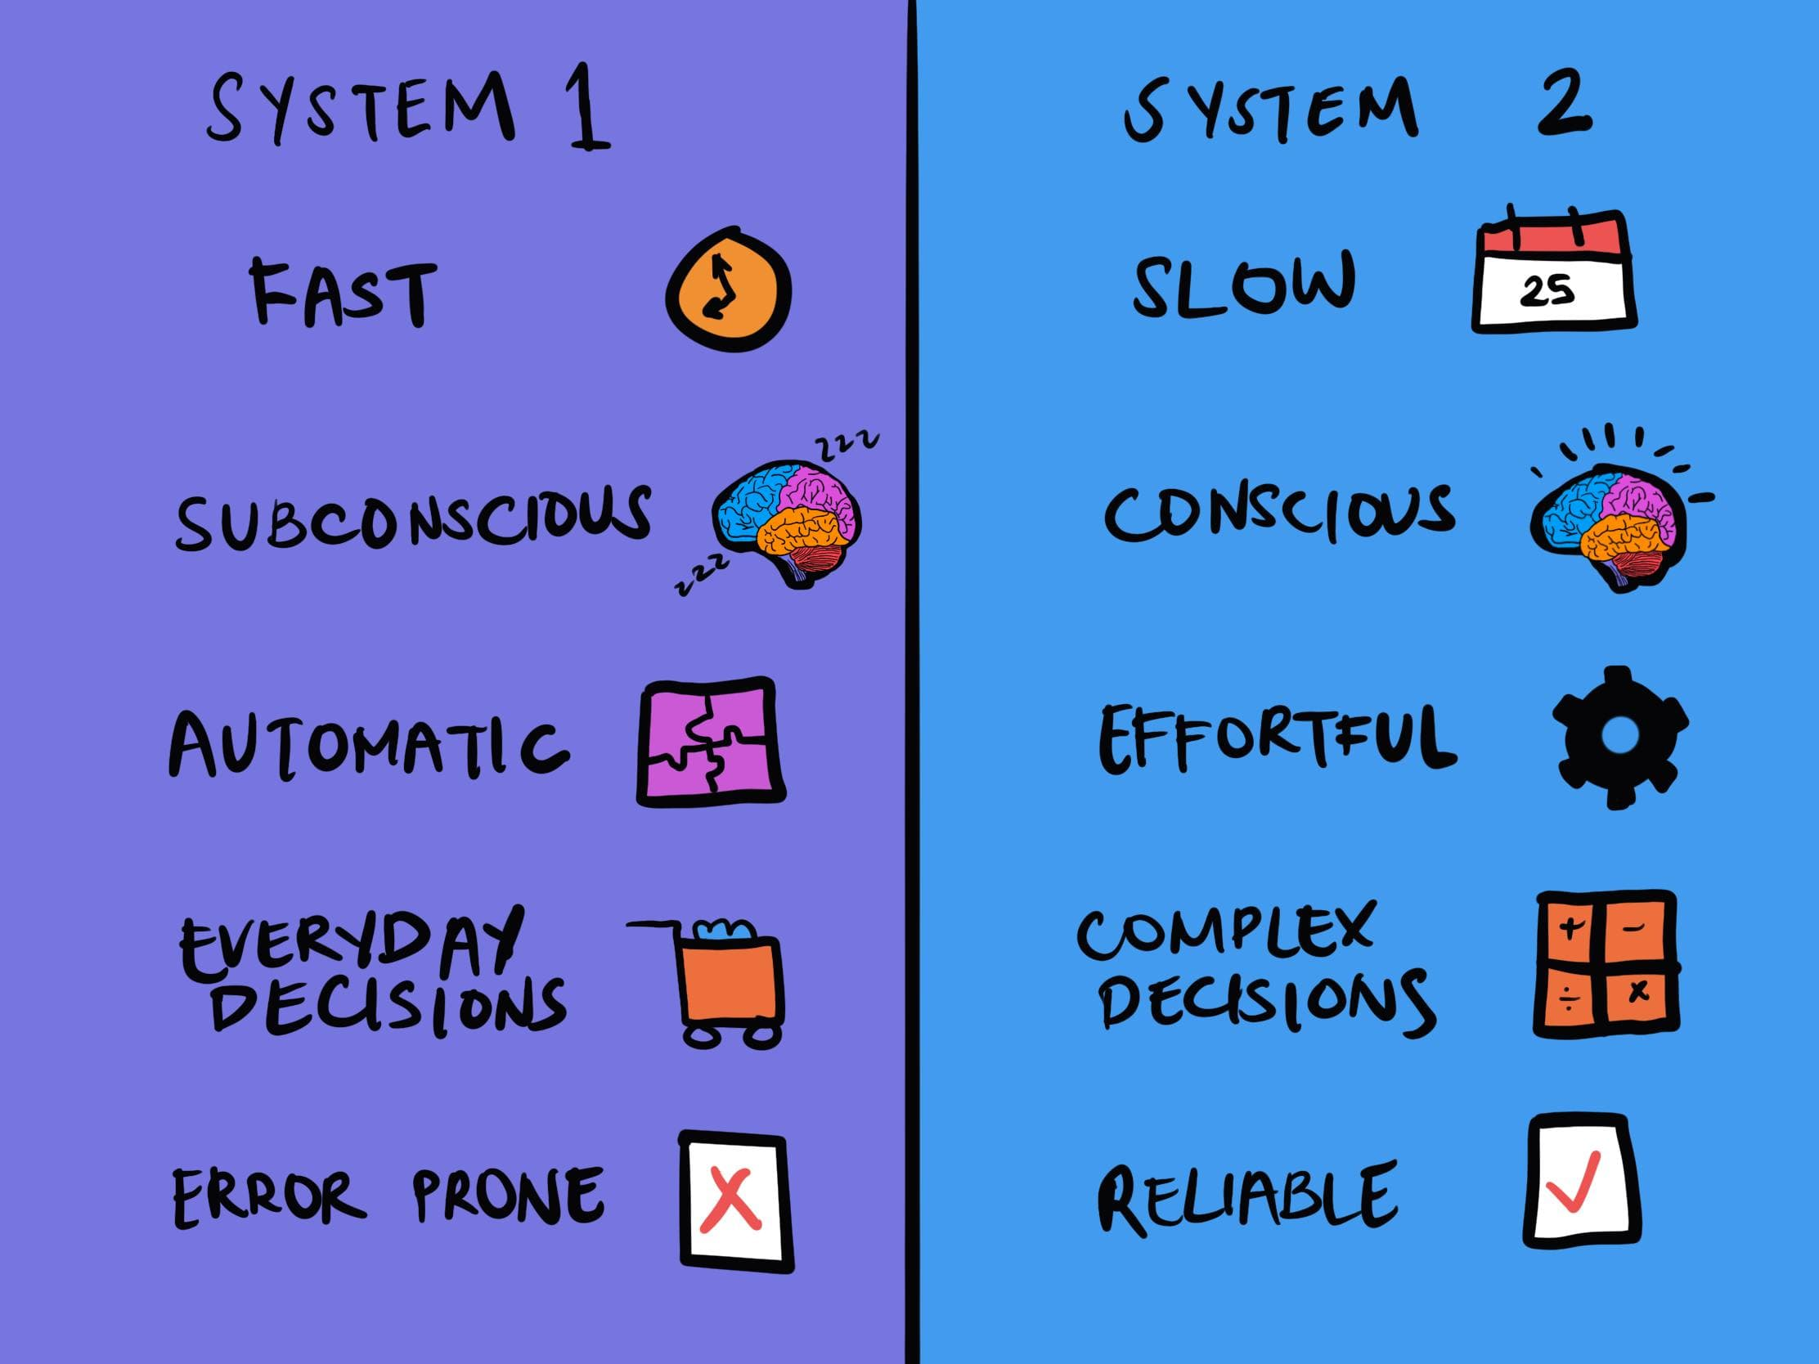
Daniel Kahnemann Systems 1 and 2 Thinking
Thinking fast: Automatic, involuntary
Thinking slow: Effortful, deliberate
Change people’s behaviour by changing
their environment
make desirable behaviour the natural choice

Slide 8
Behavioral Design
Understand behaviour and psychology to create change
Use design to shape or influence human behaviour
Frame sustainable choices
Triggers – arouse curiosity and increase perception
Action – generate behaviour
Variable rewards – optimize experience
Investment – forming habits

Slide 9
Digitainability
Promote sustainability through digitalization
Manage carbon footprint and energy consumption of digital solutions
Transparency in ESG reporting requires digitalization
Beyond optimization and cost savings
Sustainable digital transformation
Sustainable design

Slide 10
Task for Groups
Taking your starting point in Denmark’s challenges with circularity i.e. CGR/Denmark and the global challenges for Shift countries in CGR 2024 your group is to describe how both companies such as e.g. Resource Denmark, WUP and Quantafuel and you as individuals can contribute to improving Denmark’s circularity score and reduce the amount of plastic waste and increase the reuse of plastic and how it is possible to motivate Danes to prioritise secondary plastic through design and digitainability. You must include relevant SDGs in your presentation.

Slide 11
Inspiration for Groupwork
https://uxmag.com/articles/what-is-behavioral-design
https://www.recycledplastic.com/digitisation-of-waste-management/
https://www.plasticsforchange.org/
https://plast.dk/fra-udvikling-til-handling/
https://www.ramboll.com/lets-close-the-gap/circularity
Design Guide: Reuse and Recycling of plastic packaging for private consumers – se Teams
Circular Plastic Pure Business (Teams)

Slide 12
Inspiration for Groupwork
https://wpu-dk.com/en/
https://resourcedk.com/en/
https://www.dti.dk/services/key-industrial-companies-join-forces-against-plastic-waste/44251
https://theoceancleanup.com/
The Trash Tsunami

